Slide 1
CS4038
DATA MINING
LECTURE # 16
FALL 2022
FAST – NUCES, CFD CAMPUS
AYESHA LIAQAT
ayesha.liaqat@nu.edu.pk

Slide 2
TODAY’S TOPICS
Methods to estimate classifier accuracy
Holdout
Cross validation and alternatives
Classifiers evaluation metrics
Confusion matrix and evaluation measures (accuracy, error rate, sensitivity, specificity, precision, recall)

Slide 3
CLASSIFIERS EVALUATION METHODS

Slide 4

Tid | Attrib1 | Attrib2 | Attrib3 | Class
1 | Yes | Large | 125K | No
2 | No | Medium | 100K | No
3 | No | Small | 70K | No
4 | Yes | Medium | 120K | No
5 | No | Large | 95K | Yes
6 | No | Medium | 60K | No
7 | Yes | Large | 220K | No
8 | No | Small | 85K | Yes
9 | No | Medium | 75K | No
10 | No | Small | 90K | Yes
Learning algorithm
Induction
Learn Model
10
Training Set
Model
Apply Model
Tid | Attrib1 | Attrib2 | Attrib3 | Class
11 | No | Small | 55K | ?
12 | Yes | Medium | 80K | ?
13 | Yes | Large | 110K | ?
14 | No | Small | 95K | ?
15 | No | Large | 67K | ?
Deduction
10
Test Set
5

Slide 5
TRAINING VS.TEST SET
Problem: Finite data are available only and have to be used both for training and testing.
More training data gives better generalization.
More test data gives better estimate for the classification error probability.
Never evaluate performance on training data. The conclusion would be optimistically biased.
Partitioning of available finite multiset of data to training / test multisets.
Hold out.
Cross-validation
Bootstrap
Once evaluation is finished, all the available data can be used to train the final classifier.

Slide 6
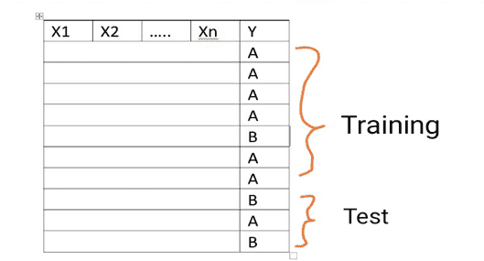
EVALUATING CLASSIFIER ACCURACY:
HOLDOUT
Purpose:
To estimate performance of classifier on previously unseen data (test set)
Holdout method
Given data is randomly partitioned into two independent sets
Training set (e.g., 2/3) for model construction
Test set (e.g., 1/3) for accuracy estimation
Pros: Simple, easy to understand and implement.
Cons: Not suitable for imbalanced training multisets.

Slide 7
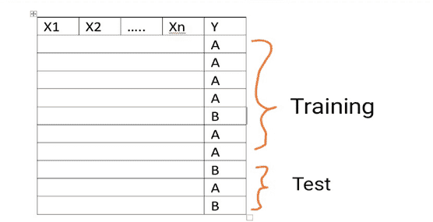
EVALUATING CLASSIFIER ACCURACY:
HOLDOUT
Repeated hold out is a variation of the hold out method:
Repeat the hold out k times, the accuracy is estimated as the average of the accuracies obtained.

Slide 8
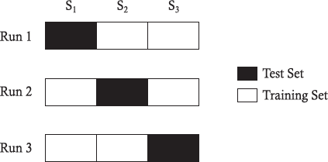
EVALUATING CLASSIFIER ACCURACY: CROSS- VALIDATION METHOD
Cross validation (k-fold, where k = 10 is most popular)
Randomly partition the data into k mutually
exclusive subsets, each approximately equal size
At i-th iteration, use D_{i} as test set and
others as training set
Example: 3-fold cross-validation

Slide 9
VARIATIONS ON CROSS-VALIDATION
Leave-one-out:
k folds where k = # of tuples, for small sized data
Repeated cross-validation
Perform cross-validation a number of times
Gives an estimate of the variance of the generalization error
Stratified cross-validation
Guarantee the same percentage of class labels in training and test
Important when classes are imbalanced and the sample is small
Use nested cross-validation approach for model selection and evaluation

Slide 10
CLASSIFIER EVALUATION METRICS: CONFUSION MATRIX
Counts of test records that are correctly (or incorrectly) predicted by
the classification model
Confusion matrix
Predicted Class
Actual Class
 | Class = 1 | Class = 0
Class = 1 | ^{F}11 | ^{f}10
Class = 0 | ^{f}01 | ^{f}00
_{Accuracy =} # correct predictions ₌
^{f}11 ^{+ f}00
total # of predictions
^{f}11 ^{+ f}10 ^{+ f}01 ^{+ f}00
^{f}10 ^{+ f}01
_{Error rate =} # wrong predictions ₌
total # of predictions
^{f}11 ^{+ f}10 ^{+ f}01 ^{+ f}00
Notes:
Correct;y classified instances

Slide 11
CLASSIFIER EVALUATION METRICS: CONFUSION MATRIX
Confusion Matrix:
Actual class\Predicted class | C₁ | ¬ C₁
C₁ | True Positives (TP) | False Negatives (FN)
¬ C₁ | False Positives (FP) | True Negatives (TN)
Given m classes, an entry, CM_{i,j} in a confusion matrix indicates # of tuples in class i that were labeled by the classifier as class j
May have extra rows/columns to provide totals

Slide 12
CLASSIFIER EVALUATION METRICS: CONFUSION MATRIX
Confusion Matrix:
Actual class\Predicted class | C₁ | ¬ C₁
C₁ | True Positives (TP) | False Negatives (FN)
¬ C₁ | False Positives (FP) | True Negatives (TN)
Example of Confusion Matrix:
Actual class\Predicted class | buy_computer = yes | buy_computer = no | Total
buy_computer = yes | 6954 | 46 | 7000
buy_computer = no | 412 | 2588 | 3000
Total | 7366 | 2634 | 10000

Slide 13
CLASSIFIER EVALUATION METRICS: CONFUSION MATRIX
A\ P | C | ¬C
C | TP | FN | P
¬C | FP | TN | N
 | P’ | N’ | All
Class Imbalance Problem:
One class may be rare, e.g. fraud, or HIV-positive
Significant majority of the negative class and minority of the positive class
Classifier Accuracy, or recognition rate: percentage of test set tuples that are correctly classified
Accuracy = (TP + TN)/(TP+TN+FP+FN)
Error rate: 1 – accuracy, or
Error rate = (FP + FN))/(TP+TN+FP+FN)
Sensitivity: True Positive recognition rate
Sensitivity = TP/(TP+FN) = TP/P
Specificity: True Negative recognition rate
Specificity = TN/(TN+FP) = TN/N
Notes:
Sensitivity= Recall ➔ medical diagnosis must diagnose a patient with a disease o.w high cost
Specificity: unnecessary treatments if due to FP

Slide 14
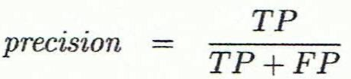
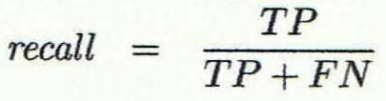
CLASSIFIER EVALUATION METRICS: CONFUSION MATRIX
Precision: exactness – what % of tuples that the classifier labeled as positive are actually positive
Recall: completeness – what % of positive tuples did the classifier label as positive?
Perfect score is 1.0
Inverse relationship between precision & recall
A\P | C | ¬C
C | TP | FN | P
¬C | FP | TN | N
 | P’ | N’ | All
16
Notes:
Actual/ Predicted
F = 50 350 = 400
NF = 9500 100 = 9600
9550 450 As dataset is highly imbalanced so accuracy is not a good measure here.
Sensitivity(Recall) identifies fraudulent as fraudulent. So it promptly identifies and addresses fraudulent activity to avoid financial losses.
Specificity: non-fraudulent as non-fraudulent. Genuine transactions are not unnecessarily blocked to maintain positive user experience.
Precision: fraudulent among all predicted fraudulent. flagged transactions are highly likely to be genuinely fraudulent, enabling more targeted and efficient fraud prevention measures.

Slide 15
ISSUES AFFECTING MODEL SELECTION
Accuracy
classifier accuracy: predicting class label
Speed
time to construct the model (training time)
time to use the model (classification/prediction time)
Robustness: handling noise and missing values
Scalability: efficiency in disk-resident databases
Interpretability
understanding and insight provided by the model
Other measures, e.g., goodness of rules, such as decision tree size or compactness of classification rules

Slide 16
READING MATERIAL
Chapter 4:Tan, Steinbach & Kumar
Chapter 8: Han, Kamber & Pei
An article on classifier evaluation:
https://towardsdatascience.com/evaluating-classifier-model-performance- 6403577c1010
An article on Cross-validation methods: https://www.mygreatlearning.com/blog/cross-validation/

